Slide 1

Who Will Carry the Ball on Teacher Pay?

Slide 2
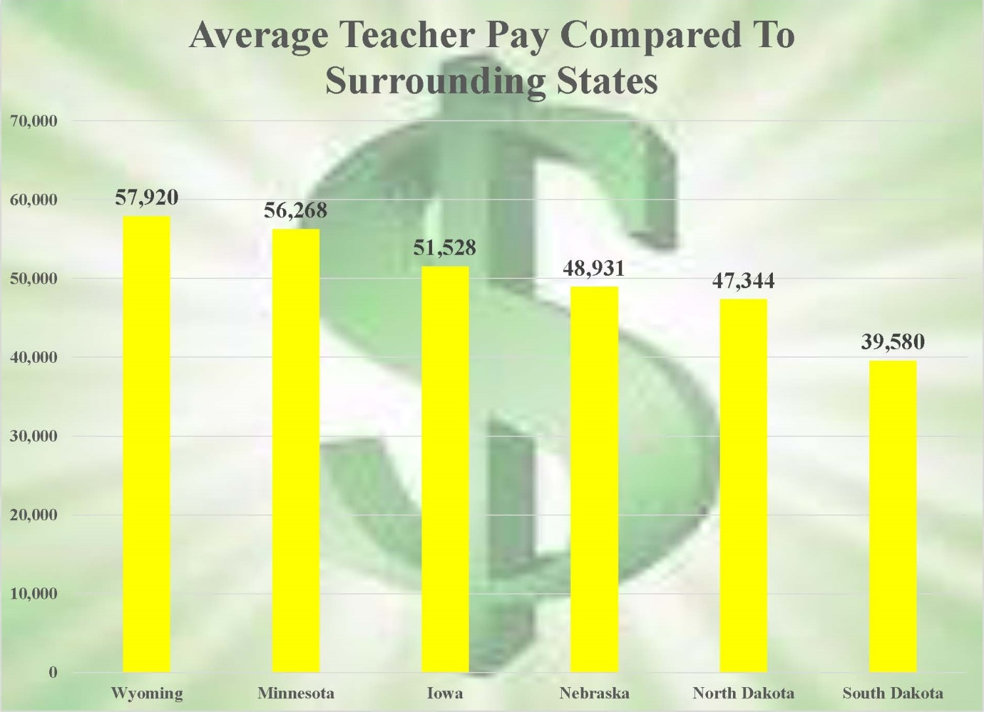
Average Teacher Pay Comparison

Slide 3
Why in South Dakota?
1. All salaries in SD not as high as other states
2. Rural - housewives
3. Conservative political scene
4. No strong union

Slide 4
Who’s to blame for low teacher pay?

Slide 5
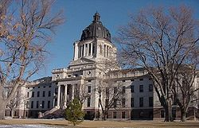
Legislature and Governor – No doubt blame is laid there; always has been

Slide 6
1. Not willing to raise or add taxes
Legislature and Governor
2. Campaigns well
3. Use local control (opt-out) as their out – “Cop Out”

Slide 7

Boards

Slide 8
1. Used to be tied to corn prices
2. Conservative by nature
3. Public pressure to not have
teachers make too much.
4. Not willing to increase taxes

Slide 9
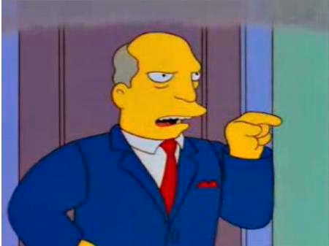

SUPTS

Slide 10
1. Stay out of negotiations - unpopular
2. Some on thin ice themselves
3. Run like a for-profit business
4. Don’t trust state government

Slide 11

Teachers

Slide 12
1. Beginning salaries – mac & cheese
Teachers
2. Teacher’s transferring in
3. Insurance – Not evenly distributed
4. Golf all summer

Slide 13
Teacher Shortages
For real – here to stay. Going to get worse.
Location, Location, Location

Slide 14
1. More pay to compare to other states $8,000 more
Solutions
2. More pay - $5,000-$10,000 in rural
3. Market pay

Slide 15
Fund Balances
Why?

Slide 16
Why Not?
1. Not a for-profit business
2. Shouldn’t tax to save
3. Less support from Pierre-
Excuse?

Slide 17
Fund Balances
1. Security for rainy day
State freeze or cut
Unexpected costs
2. Hedge against consolidation

Slide 18
Fund Balances
3. Unpredictable increases in revenue
4. Sometimes own money from opt out

Slide 19
Schools With Low Average Teacher Pay and High Fund Balances:
134% fund balance $2,178,885
19 FTE
$3,033 under state average
$65,118 to get teachers to our state - average

Slide 20
Schools With Low Average Teacher Pay and High Fund Balances:
127% Fund Balance $2,311,074
25 FTE
$5,130 under state average
$144,922 to get teachers to our state - average

Slide 21
Schools With Low Average Teacher Pay and High Fund Balances:
C. 130% Fund Balance $1,913,562
20 FTE
$7,674 under state average
$173,432 to get teachers to our state - average

Slide 22
Schools With Low Average Teacher Pay and High Fund Balances:
D. 95% fund balance $1,661,545
27 FTE
$6,093 under state average
$185,897 to get teachers to our state - average

Slide 23
Interesting Facts
Of the bottom 30 schools in average pay, 19 of them have fund balances over 40% (not counting Impact Aid).
Of the top 28 school in average teacher pay, there are only 20 schools over 40% - Lead Deadwood and Douglas.
Only Douglas School’s average is above ND state average.
There are 66 schools with over 40% fund balance (not including Impact Aid).

Slide 24
Interesting Facts (cont’d)
Most of the largest schools have high average teacher pay. 13/15 schools with 100+ teacher are in the top 26.
None of the lowest 38 paying schools have over 34.
Nearly 10% of our schools are running a fund balance over 100%, if you include Impact Aid.

Slide 25
Who Needs To Lead This Charge?
ALL FOR ONE
ONE FOR ALL

Slide 26
Supt’s can’t sit back and stay quiet
1. Boards
2. Teachers
3. Public
4. Lobbying Politicians

Slide 27


