Slide 1
Teen Up – Your Roadmap to Teen Advocacy
The Future of Rapid City

Slide 2
Make a Difference… Share your Voice… Influence Change!!
Students from Rapid City, SD have partnered with adults to engage their peers in pressing issues, share their voice, and impact their school, city and state. In this interactive session, Teen Advocates will share their experiences as Superintendent Student Key Communicators, School Board Student Representatives, Civic Center Future Planning Youth Advisory Committee Members and Crash Course Advocates who testified in front of the South Dakota State Legislature.

Slide 3
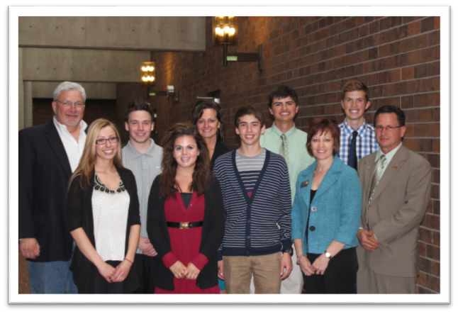
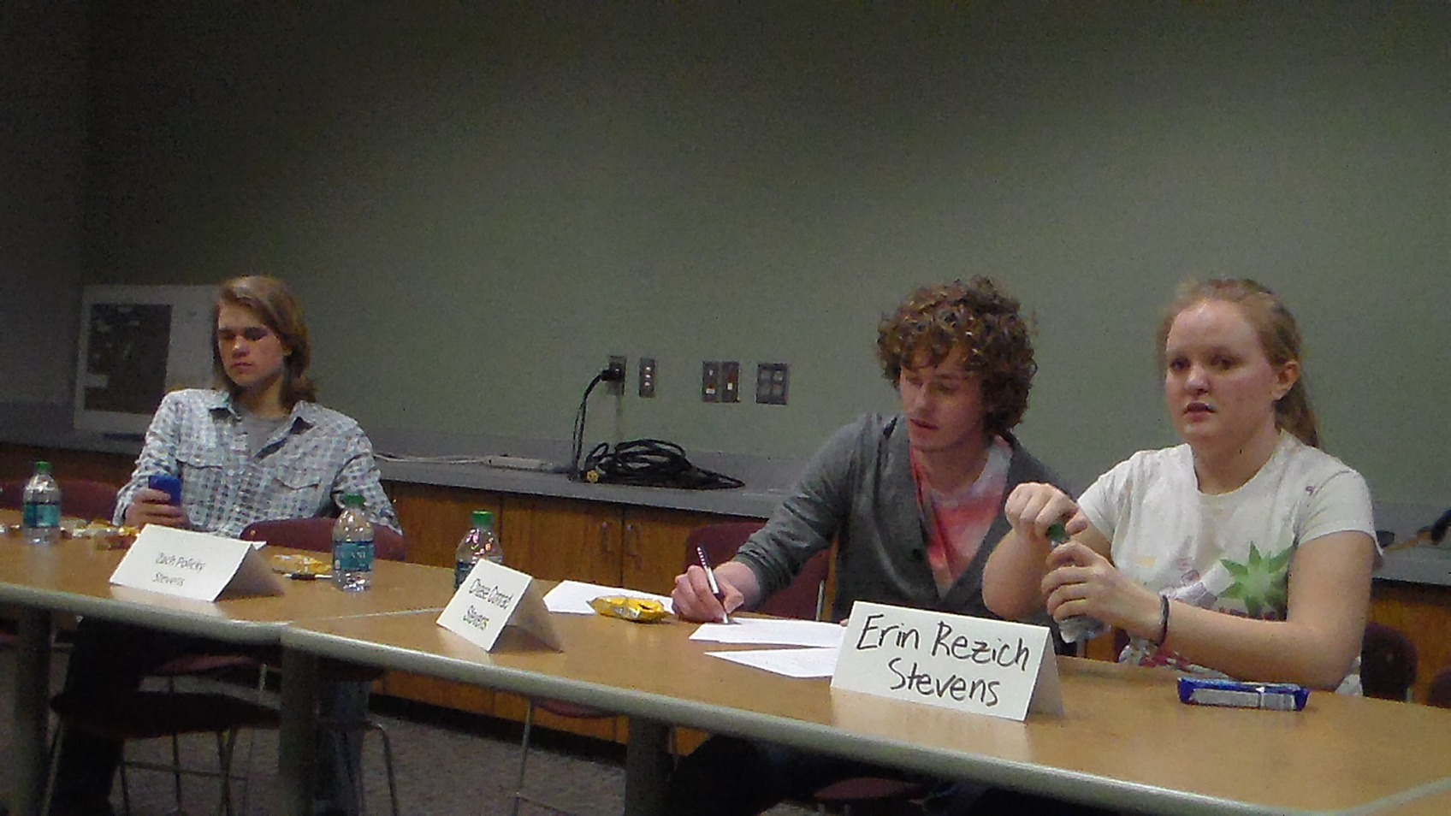
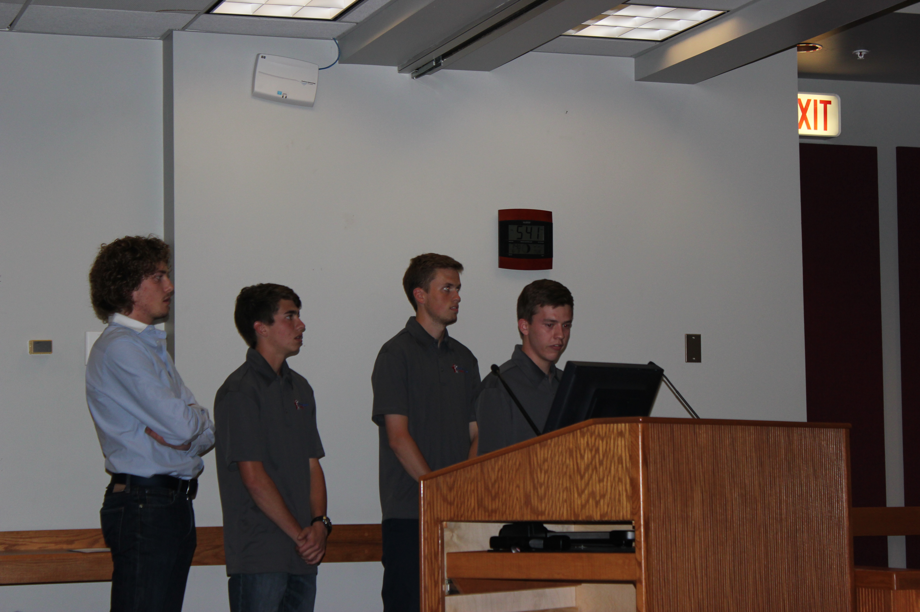
Take 45 minutes to slow down and brainstorm about what you can do to engage your students.
Learn how community based learning can change lives.
Informative, fun, interactive session with tools and worksheets that can be used in your school district
Learn how to support students in becoming stronger leaders in your community.
Explore ways to gather input and include students in decisions that impact your district.
Explore ways that your district can strengthen your community based learning.

