Slide 1
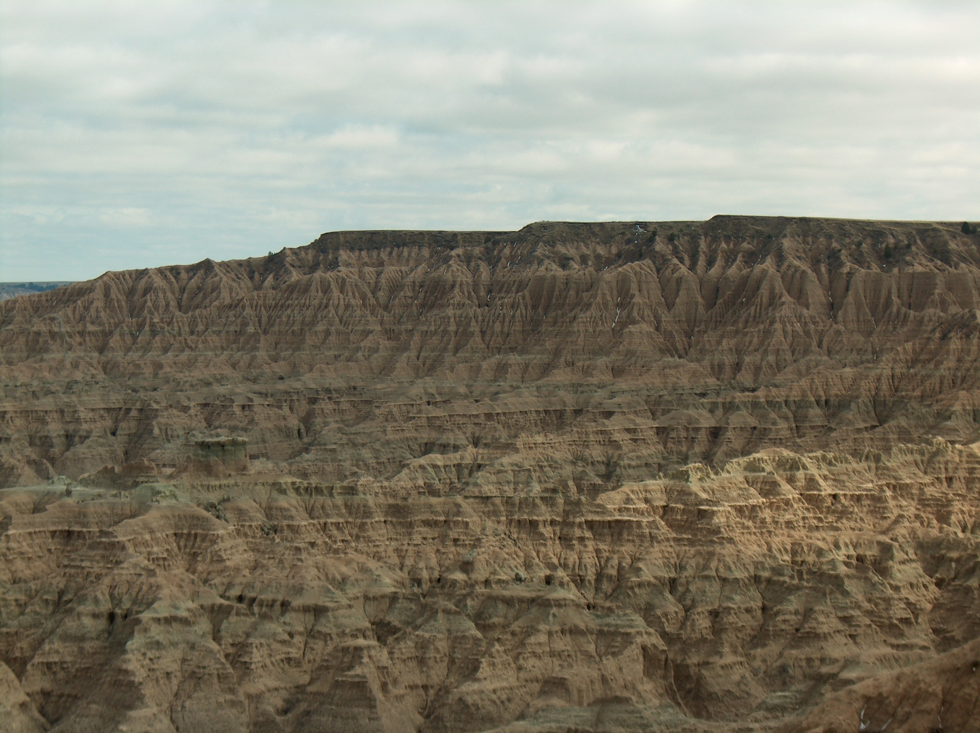
Customizing Professional Development
Wall School District 51-5

Slide 2
INDUSTRIAL AGE
SCHOOLS
INFORMATION AGE
SCHOOLS
Specific Students
can learn
Specific Subjects
in
Specific Classrooms
on a
Specific Schedule
in a
Specific Way
from a
Specific Teacher
Anyone
can learn
Anything
from
Anywhere
at
Anytime
in
Anyway
from
World Wide Experts

Slide 3
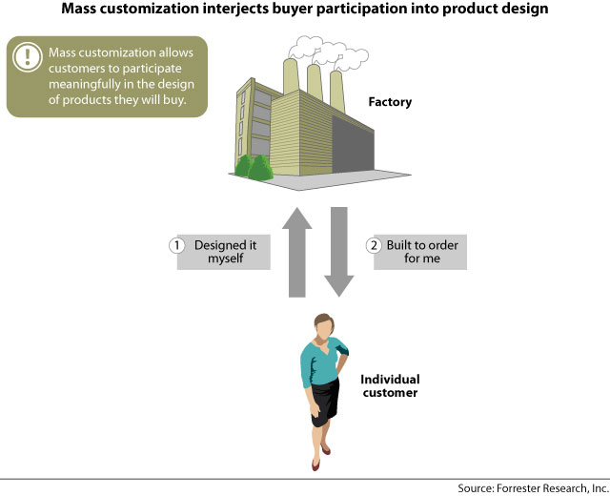

Slide 4
Time
Place
Path
Pace

Slide 5
Customizing
Professional Development
Self Assessment
Goal Setting
Action Planning
Carrying Out the Plan
Reflection and Closure
Sharing Results

Slide 6
Timelines
Self Assessment
Goal Setting
Action Planning
Carrying Out the Plan
Reflection / Closure
Sharing Results
By October 1
By October 11
By October 11
Discussion/Approval on October 25
By April 11
Presentations April 11

Slide 7
Goal Setting
Related to your professional responsibilities, but not existing teaching duties commonly expected.
Something important to you.
Can be considered a project or action research.
Progress can be documented.

Slide 8
NEW learning related to good teaching.
Instructional one goal tied to one or more of the six district priorities to improve instruction
(Framework for Teaching)
Exploratory one goal tied to your professional interest in research-based educational innovations (Framework for Teaching)

Slide 9
District Priorities
2a Creating an Environment of Respect and Rapport
2b Establishing a Culture for Learning
2c Managing Classroom Procedures
3a Communicating With Students
3c Engaging Students in Learning
4c Communicating with Families

Slide 10
Two Goals
Exploratory
Educational Innovations
Instructional
Improve Instruction
To improve classroom management in order to increase instructional time.
To learn more about Cooperative Learning to improve the effectiveness of group work in my classroom.

Slide 11
Celebration of Professional Learning
Share your experience and learning in 5-10 minutes by addressing the following questions. Use any format you wish for your presentation.
  To what extent did you achieve your goals? (Include both your instructional goal and your exploratory goal)
  What evidence or artifacts can you share about your learning and/or your students’ learning?
  How did your customized PD this year help you to improve student learning?
  How did this work help you to deepen your understanding of the Framework for Teaching component(s) you targeted?

Slide 12
Reflection
To what extent did you achieve your goal?
Did you find it necessary to modify your goal as you learned more about it?
In what ways were your colleagues helpful to you in working toward your goal?
Do you intend to keep working on this goal next year? Why or why not?

Slide 13

Teacher Experiences with Customized Professional Development

Slide 14
Samra’s Experience

Slide 15
Live Binders

Slide 16
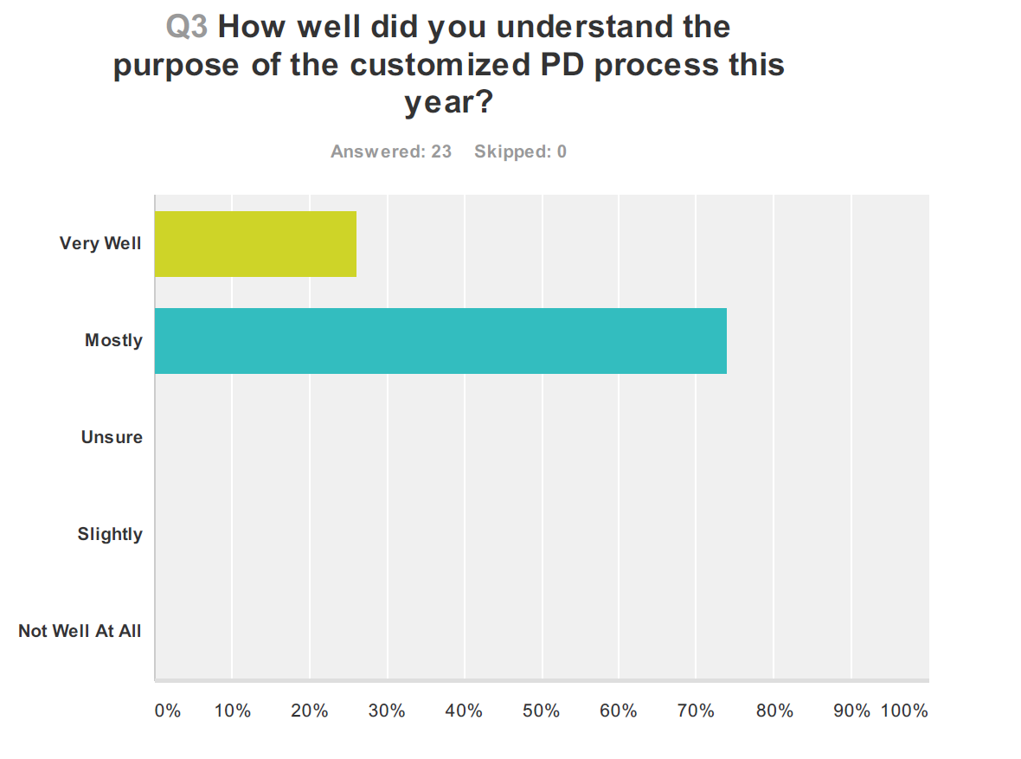

Slide 17
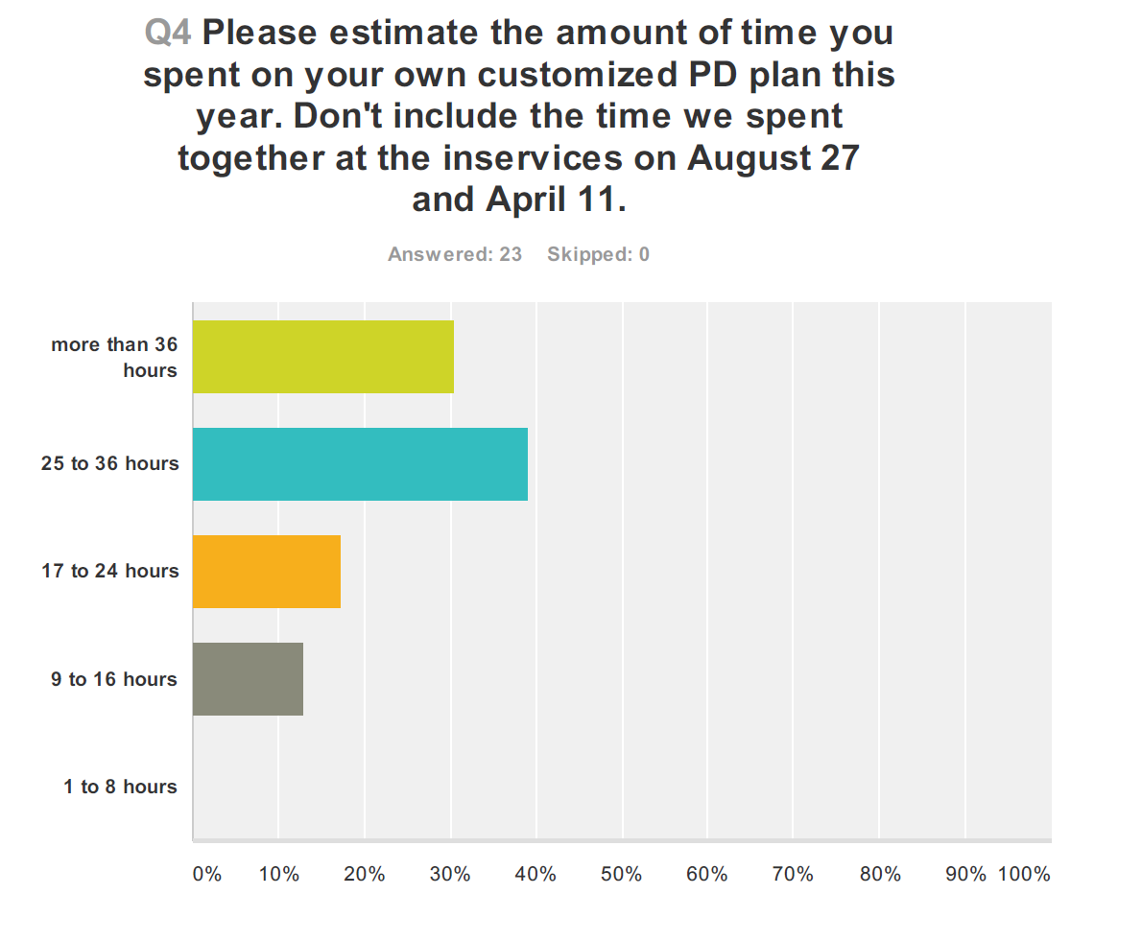

Slide 18
What was the most challenging part of the customized PD process for you?
Determining Goals
Finding Time
Technology

Slide 19
What was the most beneficial part of the customized PD process for you?
Having a Choice
It Was Useful

Slide 20
In what ways could you transfer your experience with customized learning to your students?
Allow more student choice
More self-paced projects

Slide 21
How do you think the customized PD process affected the culture and relationships within the district?
It caused stress.
It caused us to work together.

Slide 22
How could the process for customized PD be improved for next year?
Encourage us to continue with the same goals.
Allow sufficient time to complete the process.
Improve how technology is used to support the process.
Strengthen and fine tune the process, don’t add more.

Slide 23
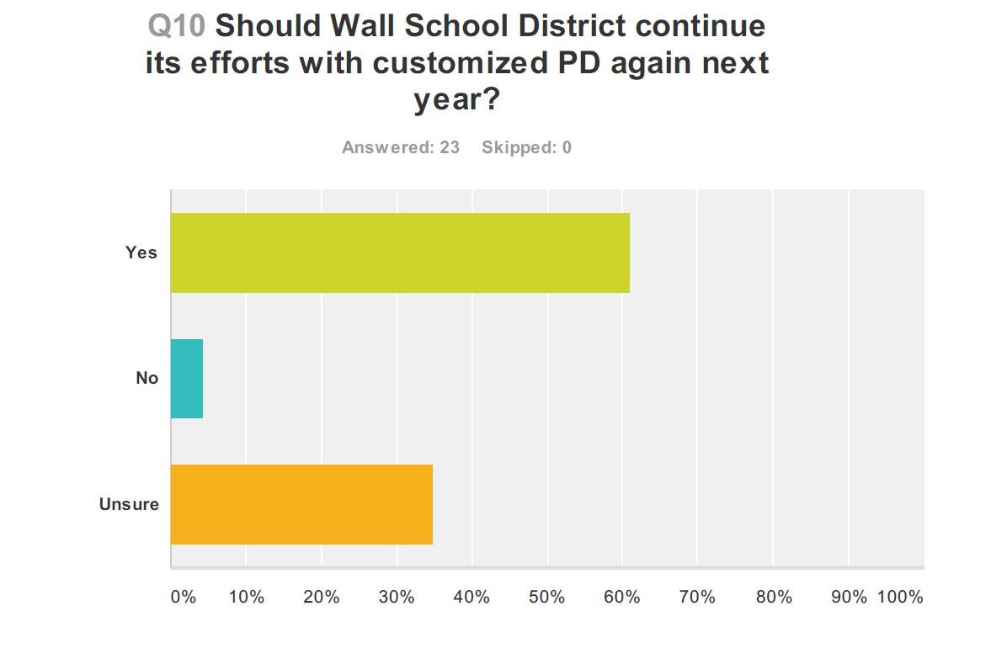

Slide 24

Questions and Comments?

