Slide 1
How Does Student Growth Measure a Teacher’s Worth?
Dianna Tyler & Pat Hubert
ASBSD Joint Conference
Notes:
Use your own pictures. Something you’ve had an objective and a positive results to that objective.
My objective was having my kids be responsible, educated adults and (so far) that has succeeded.

Slide 2
Agenda
Introductions and welcome
What is an SLO?
The SLO Process Guide
The SLO in Teachscape
How does an SLO fit into the Teacher Effectiveness System?
Notes:
This is a loose agenda for the day without times.

Slide 3
A Little Bit of History
South Dakota’s work to develop meaningful educator effectiveness systems is united by a common aspiration: To improve instruction and student learning.
The 2010 Teacher Standards Workgroup
Adopted Charlotte Danielson Framework for Teaching now known as The SD Framework for Teaching
The 2011-2012 Teacher Standards Pilot Districts
The 2012 Teacher Evaluation Workgroup
The SD Commission of Teaching and Learning
The 2013-2014 Teacher Effectiveness Pilot participants
The 2013-2014 Principal Effectiveness Pilot participants
The University of South Dakota
Notes:
Read through the aspiration and the groups that have been working to put the Teacher Effectiveness System together.

Slide 4
More History…
Evaluations in the past in SD
Teacher evaluation and NCLB waiver
SD Teacher Effectiveness Model: 2 parts
Professional practice (SD Framework for Teaching)
Student Growth
How does it all fit together?
Notes:
Evals in the past have not been standardized – varied WILDLY from district to district.
SD submitted a waiver in order to meet NCLB requirements in a way that worked for SD teachers.
Districts have the choice to adopt the SD Framework for Teaching and the SLO process OR keep their current system If crosswalk indicates that criteria of the law is met.
We will be explaining in the following slides how each of the two parts work together

Slide 5
Determining Teacher Effectiveness
Using multiple measures of professional practice and student learning
South Dakota Framework for Teaching
The Recommended Model!
Student Growth
Domain 1
Domain 2
Domain 3
Domain 4
SLOs
Planning and Preparation
Classroom Environment
Instruction
Professional Responsibilities
State Assessments
(as one measure if available)
District Assessments
Evaluator-Approved Assessments
Classroom Observations and Evidence of Effective Practice
Components from Each of the 4 Domains
At Least 8 Components Chosen Based on District or School Priorities
Professional Practice Rating
Growth Rating
Summative Rating Matrix
Professional Oversight: Is the rating fair and accurate based on the evidence
and data shared by the teacher
Differentiated Performance Categories
Below Expectations
Meets Expectations
Exceeds Expectations
Notes:
Review with teachers the Teacher Effectiveness System. This slide takes you through the 2 parts of the system – piece by piece.

Slide 6
Determining Teacher Effectiveness
Using multiple measures of professional practice and student learning
South Dakota Framework for Teaching
Student Growth
Domain 1
Domain 2
Domain 3
Domain 4
SLOs
SLOs
Planning and Preparation
Classroom Environment
Instruction
Professional Responsibilities
State Assessments
(as one measure if available)
District Assessments
Evaluator-Approved Assessments
Classroom Observations and Evidence of Effective Practice
Components from Each of the 4 Domains
At Least 8 Components Chosen Based on District or School Priorities
Professional Practice Rating
Growth Rating
Summative Rating Matrix
Professional Oversight: Is the rating fair and accurate based on the evidence
and data shared by the teacher
Differentiated Performance Categories
Below Expectations
Meets Expectations
Exceeds Expectations
Notes:
This slide singles out the SLO (Student Growth) process that we’ll be talking about today.
This is the “recommended” Teacher Effectiveness Model in SD

Slide 7
Summative Scoring Matrix
Summative Teacher Effectiveness Rating Categories
Judgment
Rating Subject
to Review
Below Expectations
Meets Expectations
Exceeds Expectations
✪
Notes:
You can see in this grid that both parts of your evaluation come together to determine one score. (Go through a scenario – Proficient in professional practice and expected in student growth rating and where that falls into meets expectation.

Slide 8
Teacher A
Summative Teacher Effectiveness Rating Categories
Judgment
Rating Subject
to Review
Below Expectations
Meets Expectations
Exceeds Expectations
✪
Notes:
For example….
Teacher A has good observations, and has artifacts/evidence that support a Proficient level of performance according to The SD Framework (Danielson).
SLO’s are set, monitored and “Expected” growth is achieved.
The two measures are applied to the matrix and where the two meet indicate “Meets Expectations” Rating for Teacher A.

Slide 9
Teacher B
Judgment
Rating Subject
to Review
Summative Teacher Effectiveness Rating Categories
Judgment
Rating Subject
to Review
Below Expectations
Meets Expectations
Exceeds Expectations
✪
Notes:
Another example.
Teacher A has less than great observations, and has artifacts/evidence that support an Unsatisfactory level of performance according to The SD Framework (Danielson).
SLO’s are set, monitored and “High” growth is achieved.
The two measures are applied to the matrix and this teacher too falls under “Meets Expectations” Rating for Teacher B
The rating falls under the two top/right cells..therefore it is a rating that is “subject to review” and open for a judgment call from the teachers administrator.

Slide 10
Teacher C
Judgment
Rating Subject
to Review
Summative Teacher Effectiveness Rating Categories
Judgment
Rating Subject
to Review
Below Expectations
Meets Expectations
Exceeds Expectations
✪
Notes:
Another example.
Teacher C has fantastic observations, and has artifacts/evidence that support a Distinguished level of performance according to The SD Framework (Danielson).
SLO’s are set, monitored and “low” growth is achieved. (This may be a very low achieving group of students…or perhaps the “Distinguished” rating is a bit inflated?)
The two measures are applied to the matrix and this teacher also falls under “Meets Expectations” Rating for Teacher C.
The rating falls under the two bottom/right cells..therefore it is a rating that is “subject to review” and open for a judgment call from the administrator.
In the final analysis, if the Professional Practice Rating and the Student Growth Rating are two totally opposite ratings….the administrator may choose to make a judgment call on the teachers summative rating.

Slide 11
Student Growth
Let’s Define It!
Student Learning Objective
Student growth is defined as a positive change in student achievement between two or more points in time. Using a measure of student growth – as opposed to using student achievement results from a single test delivered at a single point in time – is more reflective of the impact an individual teacher has on student learning.
A Student Learning Objective is a teacher-­‐driven goal or set of goals that establish expectations for student academic growth over a period of time. The specific, rigorous, realistic and measurable goal(s) must be based on baseline data and represent the most important learning that needs to occur during the instructional period. SLOs are aligned to applicable Common Core, state or national standards.
Notes:
Have participants read each definition on their own. Jot down some key points or key words for each definition. Turn to elbow partner and explain the difference between the two.

Slide 12
How many SLOs?
A minimum of 1 SLO per teacher is required.
Teachers can write more, but only one is required by the state and used for evaluation purposes.
Districts may require more than one SLO.
Notes:
This is the minimum requirement of the SLO. Each teacher should ask (or know) what is expected of them back in their home district.

Slide 13
Sample Growth Goal
For the 2014-15 school year, 90% of my students will pass the end of the year teacher created Civics assessment with a score of 70% or better.
This example is the end
result of working through
the SLO development.
Notes:
This was a sample growth statement by one of the Pilot School teachers this past year.

Slide 14
Oops…

Slide 15
The SLO Process
SLO Development
Prioritize Learning Content
What do I want my students to be able to know and do?
SLO Approval
Analyze data and develop baselines
Where are my students starting?
Select or develop an assessment
What assessments are available?
Ongoing Communication
Write growth goal
What can I expect my students to achieve?
Prepare for Summative
Notes:
This shows the SLO development has multiple steps that we’re going to walk through in a bit. This graphic gives you an overview of the steps.
The next slides break down each one of the steps. The SLO development answers 4 questions –and we address those in chunk #3.

Slide 16
Process Time line
SLO Development
Aug.-Oct
SLO Approval
Fall
Progress Update
End of SLO year/semester mtg with evaluator
Notes:
This is an approximate timeline of a typical school year.

Slide 17
Step 1
SLO Development
Prioritize Learning Content
What do I want my students to be able to know and do?
SLO Approval
Analyze data and develop baselines
Where are my students starting?
Select or develop an assessment
What assessments are available?
Ongoing Communication
Write growth goal
What can I expect my students to achieve?
Prepare for Summative
Notes:
This shows the SLO development has multiple steps that we’re going to walk through in a bit. This graphic gives you an overview of the steps.
The next slides break down each one of the steps. The SLO development answers 4 questions –and we address those in chunk #3.

Slide 18
Step 2
SLO Development
Prioritize Learning Content
What do I want my students to be able to know and do?
SLO Approval
Analyze data and develop baselines
Where are my students starting?
Select or develop an assessment
What assessments are available?
Ongoing Communication
Write growth goal
What can I expect my students to achieve?
Prepare for Summative
Notes:
This shows the SLO development has multiple steps that we’re going to walk through in a bit. This graphic gives you an overview of the steps.
The next slides break down each one of the steps. The SLO development answers 4 questions –and we address those in chunk #3.

Slide 19
Step 3
SLO Development
Prioritize Learning Content
What do I want my students to be able to know and do?
SLO Approval
Analyze data and develop baselines
Where are my students starting?
Select or develop an assessment
What assessments are available?
Ongoing Communication
Write growth goal
What can I expect my students to achieve?
Prepare for Summative
Notes:
This shows the SLO development has multiple steps that we’re going to walk through in a bit. This graphic gives you an overview of the steps.
The next slides break down each one of the steps. The SLO development answers 4 questions –and we address those in chunk #3.

Slide 20
3. Ongoing Communication
Describe student progress toward the growth goal.
If necessary, document changes in strategy.
If justified*, describe changes to the SLO
Notes:
“If Justified” for Example are on the next slide.

Slide 21
Justified Examples*
A teacher’s roster changes drastically due to high student mobility rates.
A teacher’s assignment changes significantly over the course of the year.
A teacher serves as a pull-in/push-out teacher or co-teaches.
Long-term leave
Notes:
Changing an SLO mid-way through is not something done because of poor teaching.

Slide 22
Step 4
SLO Development
Prioritize Learning Content
What do I want my students to be able to know and do?
SLO Approval
Analyze data and develop baselines
Where are my students starting?
Select or develop an assessment
What assessments are available?
Ongoing Communication
Write growth goal
What can I expect my students to achieve?
Prepare for Summative
Notes:
This shows the SLO development has multiple steps that we’re going to walk through in a bit. This graphic gives you an overview of the steps.
The next slides break down each one of the steps. The SLO development answers 4 questions –and we address those in chunk #3.

Slide 23
Understanding The SLO Process Guide
Notes:
Take a few minutes and articulate clearly that the next portion of the training is about the SLO “process”.
Try to keep attendees focused on the steps in the process guide – not to emulate the examples here – examples are provided, but it is more important to THINK about the questions asked and consider how they might answer the questions.
Coach them away from focusing on the example – steer them away from the common pitfall of “the example isnt exactly like my classroom”

Slide 24
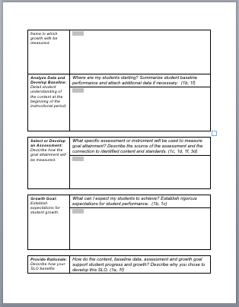
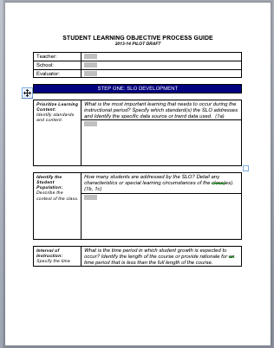
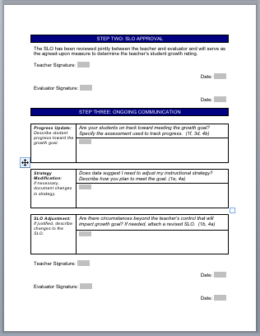
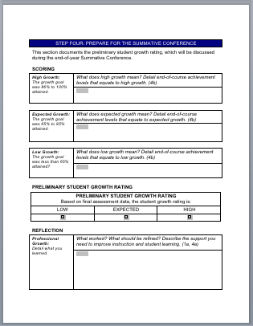
SLO Process Guide
Notes:
The process guide – helps to guide the teacher through all the steps of developing the SLO through determining growth.

Slide 25
Teachscape On-Line

Slide 26
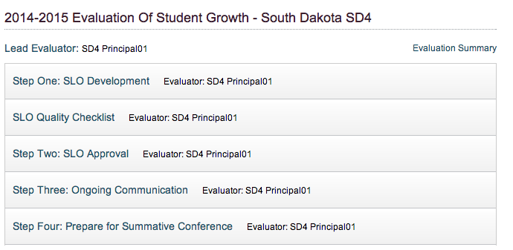

Slide 27
Teach two subjects?
If you teach two (or more) subjects go with the tested subject!
Notes:
Important to know. For example: If a teacher teaches 3 sections of PE and 2 sections of ELA – they must take the ELA because it’s a tested subject and they’ll have more data. However, this first year, if you are attending a Social studies training and also teach ELA – you can go with SS for this practice year. Once it starts being “counted” for the state, it should be in the tested area.

Slide 28
“More Common” = More Widely Used
 | STATE MANDATED ASSESSMENTS This category includes assessments mandated for use statewide and includes assessments required by state and federal law. Examples: Smarter Balanced Assessment, Dakota Step Science Assessment (or the state-required science assessment)
 | COMMON STATE AND DISTRICT ASSESSMENTS This category includes assessments not mandated for state use but are widely used by several districts and schools. Assessments in this category include commercially available assessments, district-developed pre- and post-tests or course-level assessments. Assessments could also take the form of established rubric-scored performance-based assessments. Examples: Assessments available through the South Dakota Assessment Portal, End-of-Course Exams, Write-to-Learn, WIDA-Access Placement Test (English-Language learners), National Career Readiness Certificate, DIBELS, AP Exams, STARS reading/math, MAPS, AIMS Web, CTE Performance Contests/Judging.
 | TEACHER-DEVELOPED ASSESSMENTS This category of assessments includes classroom assessments used by a single course for a particular teacher.
More Common
Less Common
Notes:
This slide just shows the definition of a “More Common” vs “Less Common” assessment.

Slide 29
The SMART Process A Format for Developing SLOs
S
Specific
The goal addresses student needs within the content.
M
Measurable An appropriate instrument or measure is selected to assess the goal.
A
Appropriate
The goal is standards-based, needs-focused (and directly addresses all students)
R
T
Realistic & Rigorous
The goal is attainable and stretches student learning.
Time-bound
The goal is contained to a single school year/course.
Notes:
Ask participants: How many of you use SMART goals regularly? have written them? Are familiar with SMART goals?
The goal must be SMART. We know that sometimes the SMART goal looks differently – but for the SD SLO this was approved by the Commission of Teaching and Learning.

Slide 30
Growth Goals
Class Mastery
Based on quality baseline data and educator-determined definition of mastery. Goal is structured based on percent of students attaining mastery.
Differentiated Growth
Establishes tiered expectations for student growth for groups of students. The educators define what growth looks like for each group of students.
Shared Performance
Teams of teachers agree to work collaboratively and share responsibility/accountability for student learning for a content area, grade level or school.

Slide 31
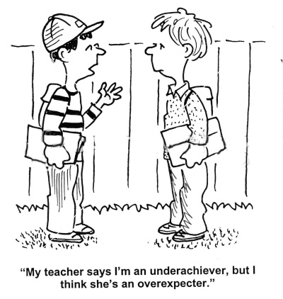

Slide 32
Teacher Student Growth Rating
PERFORMANCE
CATEGORY DESCRIPTION
Low Less than 65% goal attainment
Expected 65% to 85% goal attainment
High 86% to 100% percent attainment
Notes:
This is the state recommendation for determining growth.

Slide 36
Scores for 80% Goal
Sample SLO: At the end of the term, all students will show measurable progress in HS Chemistry as shown by the American Chemical Society National High School Final Exam. 80% of all students will obtain a score of 26 or better on the exam. (26 is considered average).
Low Less than 65% goal attainment
(.80 x .65 = Less than 52%)
Expected 65% to 85% goal attainment
(.80 x .65 = 53%) (.80 x .85 = 68%)
High 86% to 100% percent attainment
(.80 x .86 = 69%) (.80 x 100 = 80%)
Notes:
This is how you would determine growth using an 80% mastery goal.

Slide 37
Scores for 70% Goal
Sample SLO: At the end of the term, all students will show measurable progress in HS Chemistry as shown by the American Chemical Society National High School Final Exam. 70% of all students will obtain a score of 26 or better on the exam. (26 is considered average).
Low Less than 65% goal attainment (Less than 46%)
Expected 65% to 85% goal attainment (46% - 59%)
High 86% to 100% percent attainment (60% - 70%)
Notes:
Same formula – except this is 70%

Slide 38
Step 4
For the 2014-15 school year, 90% of my students will pass the end of the year teacher created Civics assessment with a score of 70% or better.
High growth is 86-100% of your goal
Expected growth is
65 – 85%
Figure where your scores must be according to your growth goal.
Low growth is
less than 65%
Notes:
STOP after the first click (Figure where your scores must be according to your growth goal) and have teachers figure this out before clicking through the rest!!!
Give teachers time to figure out what 90% would be (allow calculators).

Slide 39
Step 4
For the 2014-15 school year, 90% of my students will pass the end of the year teacher created Civics assessment with a score of 70% or better.
High growth is 86-100% of your goal
77% - 90%
Figure where your scores must be according to your growth goal.
Expected growth is
65 – 85%
59% - 77%
Low growth is
less than 65%
Less than 59%
Notes:
STOP after the first click (Figure where your scores must be according to your growth goal) and have teachers figure this out before clicking through the rest!!!
Give teachers time to figure out what 90% would be (allow calculators).

Slide 40
Principal Student Growth Rating
PERFORMANCE
CATEGORY DESCRIPTION
Low Less than 80% of teachers earned expected growth
Expected 80-90% of teachers earned expected growth
High 91-100% of teachers earned expected growth
Notes:
This slide lets teachers know that principals are also responsible for student growth ratings in their building – by how well their teachers achieve their SLOs.

Slide 41
How has DOE helped?
SLO Trainings in March for Administrators
SLO Trainings this summer for 5900 teachers this summer in many locations around the state.
On going support and coaching this school year.
This is the practice year.

Slide 42
The Big Picture
Reflect Best Practice
Flexible
Timeline, amount of growth, type, assessment
Between Teacher and Evaluator
Collaborative
Focused
Notes:
This is just what it says – the big picture!

Slide 43
Questions

Slide 44
Closure
Dianna Tyler and Pat Hubert
ESA2
Notes:
Add contact information

