Slide 1
South Dakota DOE Accountability Update
August 7, 2014 Joint Convention
Notes:
Abby JH
Welcome
Thanks
Purpose of the call
Recommendations
Models
Which is best?

Slide 2
2013-14 School Report Cards
Schedule:
Pre-appeal window closed July 18;
Changes will be made and validated next week;
Embargoed version released for district accountability teams to look at Friday, August 15;
Public Report Cards released Tuesday, August 19;
Formal Appeals due back to SD DOE by September 5, 2014

Slide 3
What data do I need to report home?
Smarter Balanced Schools
DSTEP Schools
No ELA or Math data to send home
Science reports for students who took the Science Assessment must go home (print from South Dakota Assessment Portal or from Infinite Campus)
ELA and Math reports need to go home
Science reports for students who took the Science Assessment must go home
Print from South Dakota Assessment Portal or from Infinite Campus
Public Report Cards must be shared with your stakeholders and the public as in prior years.

Slide 4
Key notes for the 2013-14 Report Cards

Slide 5
Logging Into SD-STARS
Website: https://doestars.sd.gov
User Name: Email Address
Password: Set by you

Slide 6
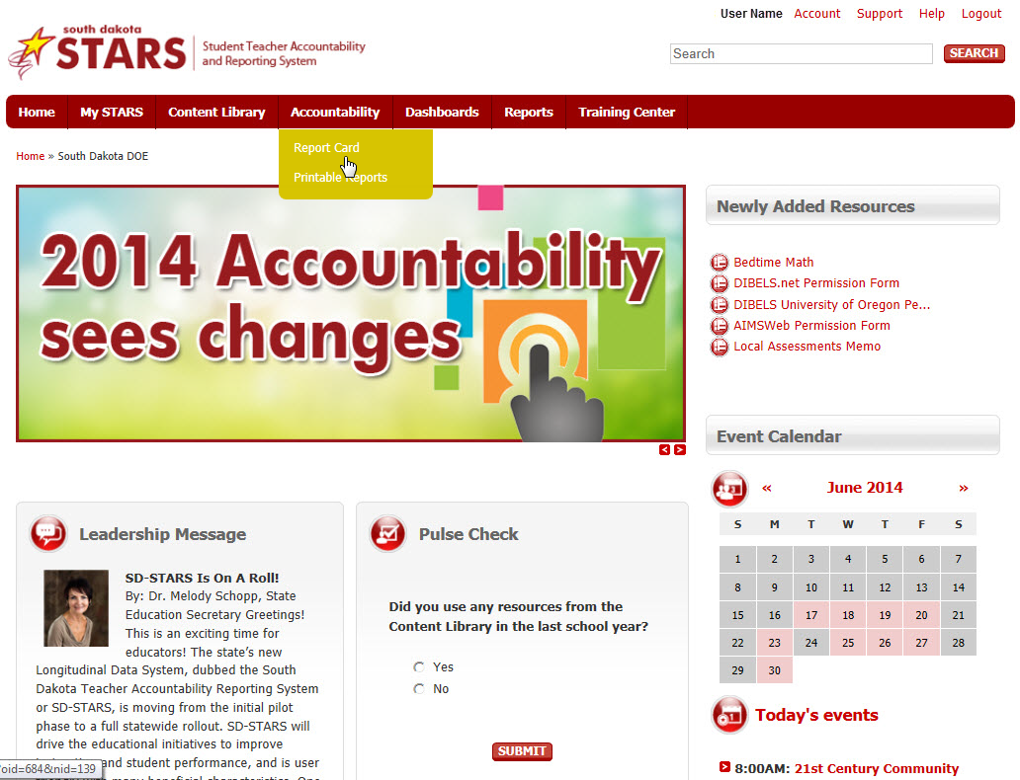

Slide 7
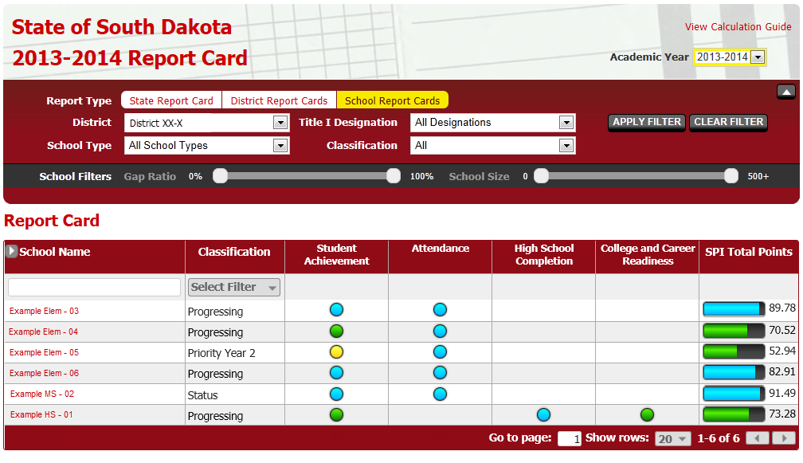

Slide 9
You now have the ability to change between years in the Report Card

Slide 10
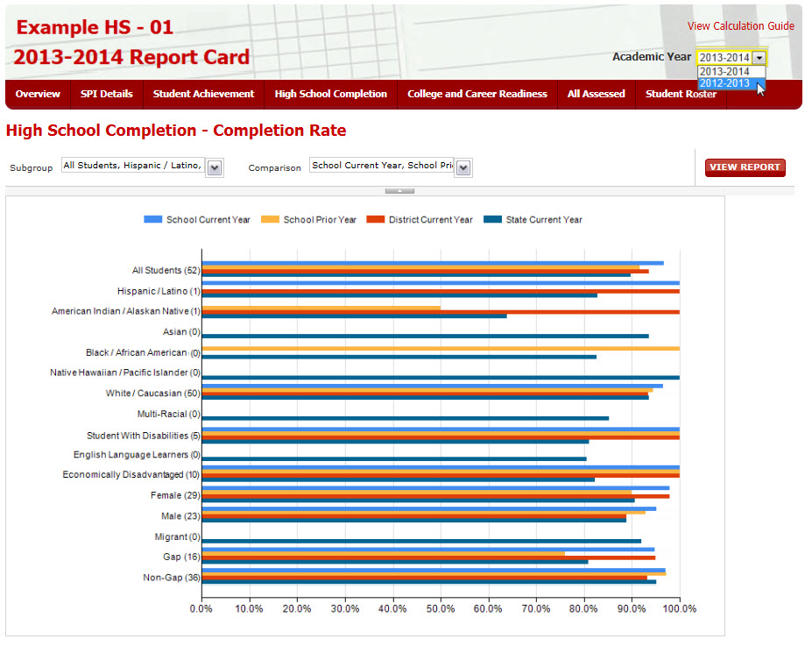

Slide 11
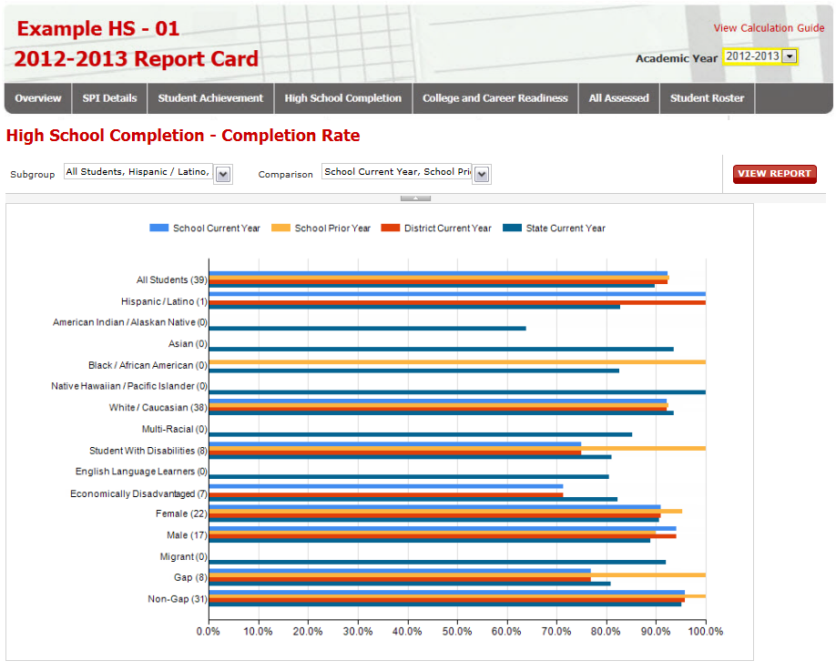

Slide 12
You can access Video Tutorials to walk you through the report card in the training center

Slide 13
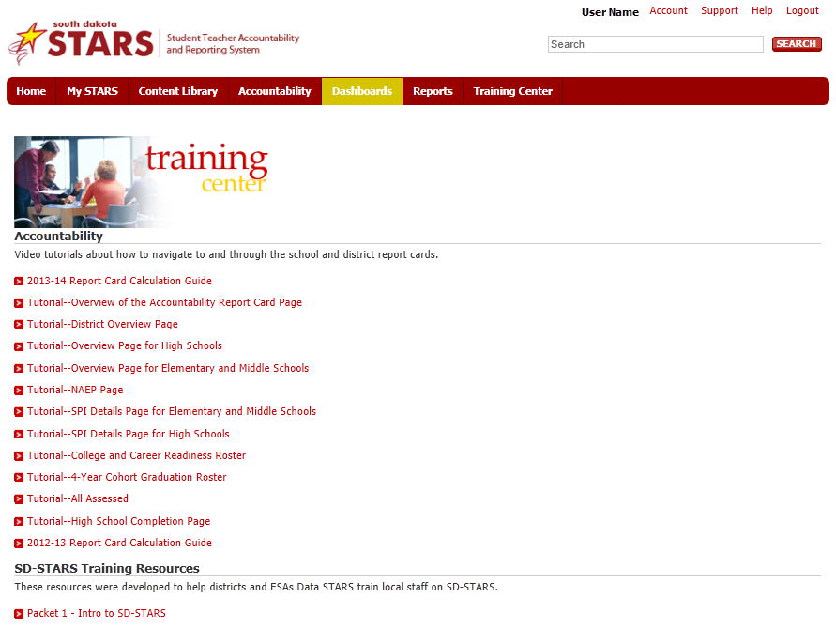
Calculation Guide
Video Tutorials on Navigating To the Through the Accountability Report Cards in SD-STARS

Slide 14
Questions about how something was calculated? Look for more information in the Calculation Guide

Slide 17
Changes for 2013-14
Because there will be no School Performance Index scores for 2013-14, current classifications remain in place.

Slide 18
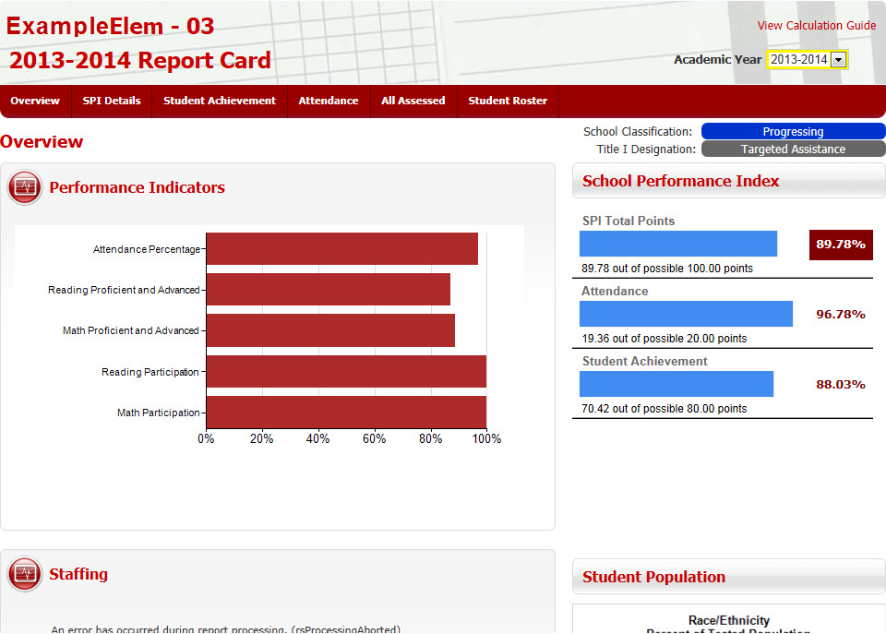

Slide 19
Changes for 2013-14
No participation rates for both Smarter Balanced and Dakota STEP schools will be reported in SD-STARS or the Accountability Report Cards
The Department will report participation rates separately later in Fall 2014

Slide 20
Changes for 2013-14
Those schools who took the Smarter Balanced assessment in 2013-14 will not have any student achievement results.
Those schools who took the paper/pencil Dakota STEP will have student achievement results.

Slide 23
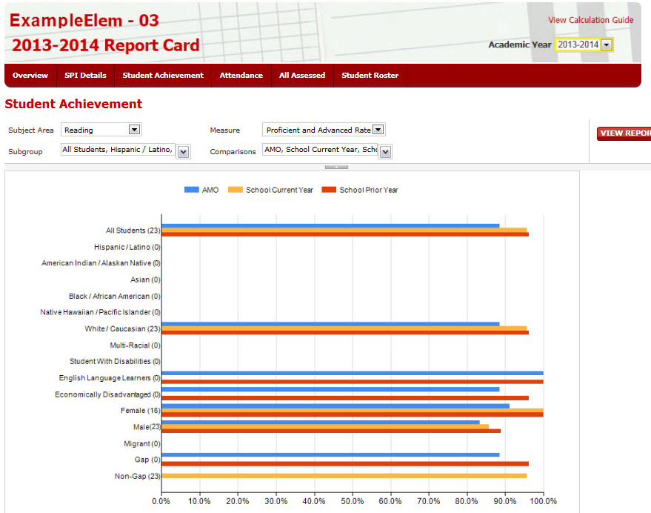

Slide 24
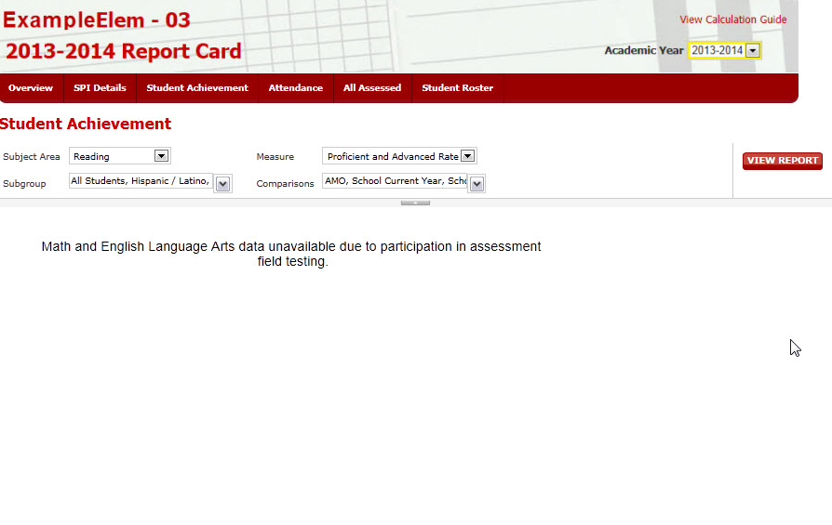

Slide 25
Everyone who had tested students in grades 5,8,11 should see Science Results in the All Assessed Report
Notes:
Parent reports

Slide 26
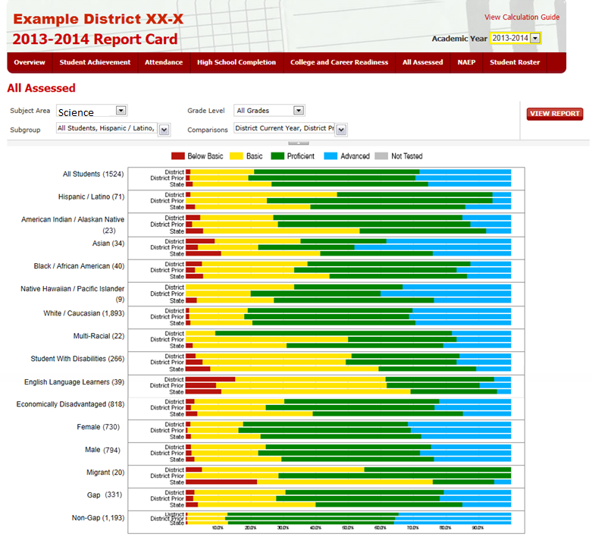

Slide 27
Accountability Moving Forward

Slide 28
Waiver Extension Process
Began collecting feedback immediately after roll out of new accountability calculations in Fall 2012
US DoE monitoring in October 2012, August 2013
Presented proposed changes in November and December 2013 to:
Board of Education
Secretary’s Advisory Council
Accountability Work Group
Committee of Practitioners
US DoE feedback received in February and March 2014
Sent out for Public Comment May 2014
Submitted May 2014
Approved July 2014 for the 2014-15 academic year
Directions for 2015-16 and beyond to come this winter

Slide 29
Changes for the 2014-15 school year
Attendance: based on the percentage of students meeting state attendance goal (94%)
Educator effectiveness and school climate officially removed from SPI, still areas of critical focus
Updates to Focus and Priority work to reflect current practice
Updated information about working with Other Title I schools
Updated information about data review and monitoring processes
Ability for Focus and Priority schools to remain in existing status if progress being made

Slide 30
2014-15 Assessment
REQUIRED ASSESSMENT:
All Public Schools will take the Smarter Balanced Assessment in ELA and Math.
Alternate Assessment students will take the NCSC.
Science will still be the DSTEP-Science in some format. SD DOE is working through the contract process now.
2014-15 is a NAEP year.
ACCESS assessment for English Learners still paper and pencil, online field test happening.
NO Additional Writing Assessment will be given.

Slide 31
2014-15 Assessment
OPTIONAL ASSESSMENT:
Schools can still use the South Dakota Assessment Portal (SDAP) to give classroom, End of Course (with a waiver), district secure, and benchmark assessments.
Many schools will use SDAP to create common assessments for SLOs.
National Career Readiness Certificate (NCRC) is available for any public high school at one grade level.
The Accuplacer exam can be used to address remediation needs before entering college.
Smarter Balanced Interim Assessments will be available this winter
Smarter Balanced Digital Library resources forthcoming

Slide 32
Smarter Balanced Field Test in South Dakota by the numbers
150/151 Public school systems
20/20 BIE/Tribal systems
36/53 Non-public systems
70,560 student took tests
279,137 tests started
278,164 tests submitted
1,200+ district personnel involved
4 SD DOE Staff with tech support from BIT

Slide 33
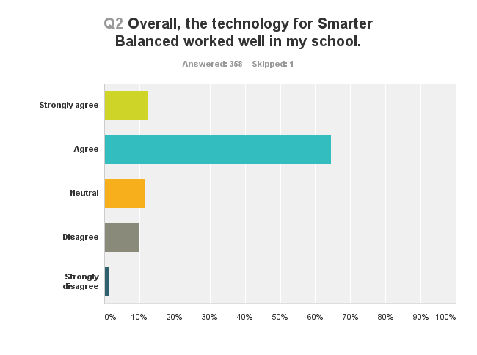
Were the schools ready?

Slide 34
Survey says….

Slide 35
Themes that emerged from the survey feedback:
If students and staff did practice tests, the field test went smoother
Tech staff must be involved
Shift to on-line testing created confusion and concerns with accommodations
Text-to-speech and sound the biggest problem across all respondents.
Wide variance in district level communication procedures

Slide 36
A comment from the field
Overall, for the field test, it went well. We all knew the test would be challenging. As a parent, my own son came home and shared that he was very glad that the writing part could be done with a keyboard. He state, “I don’t like to write, but if I could do it on a computer,…that makes it a lot easier! I wrote a lot for the Smarter Balanced test!”

Slide 37
Coming Attractions
Smarter Balanced is more than a single test!
By late fall, public schools will have access to resources for formative (Digital Library) and interim assessments (comprehensive and content blocks) .

Slide 38
Next Steps
AIR (American Institutes for Research) will be the vendor to deliver Smarter Balanced for South Dakota
October 6- 17, 2014 Online Panel for Achievement Setting
To register, go to SmarterBalanced.org/OnlinePanel

Slide 39
Next Steps: Setting Achievement Levels A Two Part Process
Part 1 October 6- 17, 2014 Online Panel for Achievement Setting
To register, go to SmarterBalanced.org/OnlinePanel
This process is open to educators, administrators, parents, community members
6 hours of time to complete

Slide 40
Next Steps: Setting Achievement Levels A Two Part Process
Part 2 In- person Panels
October 13 – 20
Educators from across the participating states
South Dakota has an equal voice in the panels
In early November, all participating states will vote on the achievement levels for each grade and each content.

Slide 41
Scores
English Language Arts
Total Scale Score and Achievement Level + information on:
Reading
Writing
Speaking/Listening
Research
Mathematics
Total Scale Score and Achievement Level + information on:
Concepts & Procedures
Problem Solving & Modeling/Data Analysis
Communicating Reasoning

Slide 42
Statewide Fall Assessment Workshops
Sept. 15 – Outdoor Campus, Rapid City
Sept. 16 – Kings Inn, Pierre
Sept. 17 – Ramkota, Aberdeen
Sept. 18 – Lake Area Tech, Watertown
Sept. 19 – Southeast Tech, Sioux Falls
Audience: District level administrators, assessment and tech staff
Time: 8 – 4
Focus: Overview of state assessment system and next steps.

Slide 43
Mapping the Future Fall 2014 and Beyond
More targeted professional development to specific groups, both in-person and web-based
Direct meetings with tech coordinators
Manuals and training materials must be teacher-friendly
Small districts – need more staff to support the district test coordinator (typically the high school counselor)
Communication on blueprints, achievement standards, and claims – reporting results

Slide 44
Future Accountability Changes
2015-16 Results and beyond
Multiple years achievement data to be included (building to 3)
Multiple ways to show College Readiness
Career Readiness as an optional measure
Student Growth measure for Elementary and Middle Schools

Slide 45
Growth Model Work Group
Spring 2013 –convened key education professionals, REL helped facilitate
Defined purpose and non-negotiables:
Fair to large and small schools
Takes growth of ALL students into account, not just “bubble kids” or non-proficient students
Ability to explain to parents and those outside the educational field
Not just another measure of proficiency

Slide 46
Purpose of Growth Model
Measure for School Accountability models (SPI) at Elementary and Middle School levels
Give all schools an additional opportunity to show gains being made as opposed to only using a proficiency based measure
NOT created for use as a mandated growth model for teacher effectiveness models
Notes:
Abby JH
Reiterate the purpose
Dig into the accountability SPI implications ELEM and MS (NOT teacher/principal effectiveness)

Slide 47
Process
REL compiled research and examples of most common models
Eliminated models that violated non-negotiables
Talked with peers and looked at examples of other models in more depth
Looked at SD data and came up with final recommendation

Slide 48
Final Models Investigated
Student Growth Percentiles and Residual Gains Models
Easier to understand and explain
Performance is compared to expected gains giving you a sense of whether adequate growth is made
Considers prior performance to determine adequate growth
Notes:
Abby JH

Slide 49
Process Used to Compare the Models
Fit both types of models using student assessment data from 2011-12 and 2012-13.
Looked at 3rd-8th grade mathematics and reading.
Examined the distribution of growth scores for students and schools.
Examined results for small (10-20) and large schools (greater than 500).
Notes:
Mary K

Slide 50
Final Recommendation
Student Growth percentiles better model SD data.
Residual gains forces a linear model. SGP allows for growth to be non-linear.
SGP has been successfully implemented in multiple states.
Benefit to comparing students to students that are like them across the state, instead of to all students in their grade.
Notes:
Abby JH

Slide 51
Student Growth Percentiles
What are SGPs?
Indicators of student growth: test scores compared to scores of students with similar score histories.
What can SGPs tell us about student growth?
How much a student grew, relative to students with a similar score history (academic peers). A student with an SGP of 65 performed better than 65% of his/her academic peers.
Which states are using SGPs?
Several have adopted as a measure of growth including Colorado, Arizona, and Utah.
Allows SD to leverage the programming, communications, and lessons learned.
Notes:
Mary K

Slide 52
Source: Castellano & Ho (2012)
Notes:
Mary K

Slide 53
Determining points in the accountability system (beginning with 2016 results)
Continuous model to parallel the way points are assigned for achievement (0-40 points).
Half the points are assigned based on the growth for the lowest 25% of students in your district/ school;
Half the points are assigned based on the growth for ALL students (MGP)
Notes:
Abby JH

Slide 54
Next Steps
Develop a template for reporting
Create communication plan and build awareness
Submit to US DoE for ESEA Flexibility approval
Release first results after SY 15-16
Continue to monitor system
Notes:
Abby JH

Slide 55
Contacts
Questions about SPI
Abby Javurek-Humig, abby.javurek-humig@state.sd.us
DOE Accountability Data Contact
Judy Merriman, judy.merriman@state.sd.us
Randy Hanson, randy.hanson@state.sd.us
Teri Jung, teri.jung@state.sd.us
Tom Morth, tom.morth@state.sd.us
Jennifer Rattling Leaf, jennifer.rattlingleaf@state.sd.us
SD-STARS Project Managers
Marcus Bevier, marcus.bevier@state.sd.us
Sara Kock, sara.kock@state.sd.us

Slide 56
Contacts
Questions about Growth
Abby Javurek-Humig, abby.javurek-humig@state.sd.us
DOE Assessment Contacts
Jan Martin, jan.martin@state.sd.us (Smarter Balanced, all general questions)
Matt Gill, matthew.gill@state.sd.us (South Dakota Assessment Portal and Digital Library)
Mike Rickert, michael.rickert@state.sd.us (End of Course Exams)
Alan Haarstad, alan.haarstad@state.sd.us (NAEP)
Ben Morrison, ben.morrison@state.sd.us (NCSC Alternate Assessment)
Yutzil Rodriguez, yutzil.rodriguez@state.sd.us (ACCESS for English Language Learners)

